Slide 1
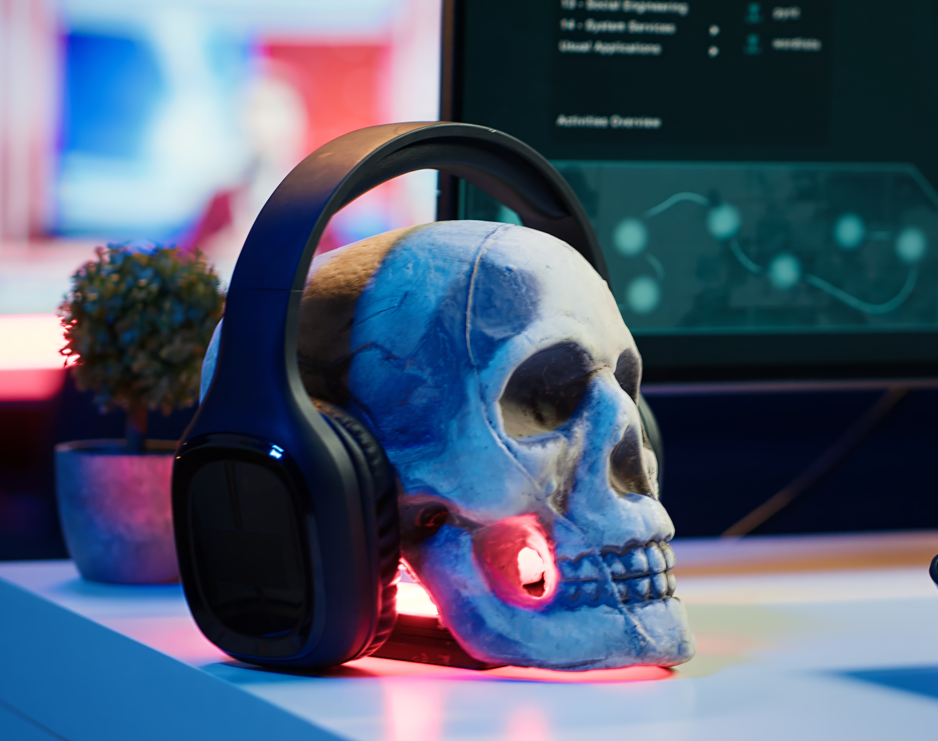
System Parasites
Group D
Lau Jade 243FC2455Y
Wong Zhi Yi 243FC243T2
Sabrina Marian Teo Sulit 243FC243Z8
Ibraheem Qashou 243FC246HM

Slide 2

Definition of computer virus
A malware that spreads between computers and affects computer system and hard disK.
Occurring the loss of data from our system and send to others.
Disruption of systems, major operational issues and leakage.
It is very vital to keep viruses out, but what exactly is a computer virus?

Slide 3
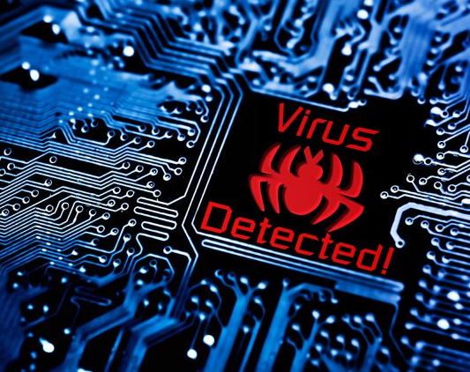
What Does a Computer Virus Do?
It depends on how it is programmed.
A harmless prank
A sophisticated and intentional, leading to criminal activities and fraud.
Spread through a network environment to find other vulnerable hosts, corrupting files and disrupting softwares.
This exposes some information and networks to repeated risks if the virus is not removed !!!

Slide 4
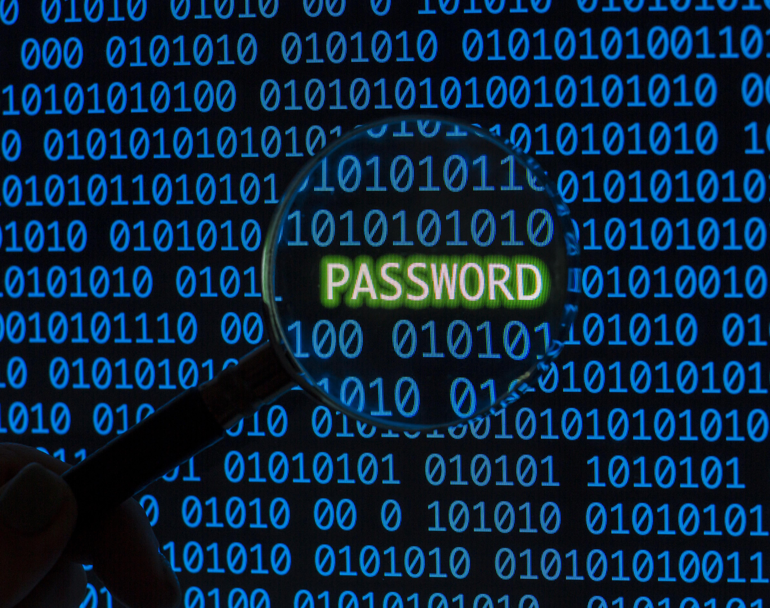
Types of computer viruses
Boot Sector Virus
Web Scripting Virus
Browser Hijacker
File Infector Virus
Macro Virus
Direct Action Virus

Slide 5

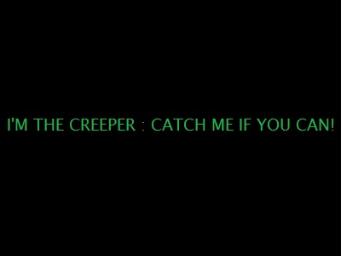
The Creeper’s System is the first ever self-replicating computer virus released during 1971. It was designed to test the viability of mobile programs that could spread across networks.
Creeper’s System
How it works?
Creeper was designed to move between DEC-PDP-10 computers on the APRENET, a precursor to the internet.
When it infected a system, Creeper would display the message “I’M THE CREEPER: CATCH ME IF YOU CAN”.
Creeper was not intended to be harmful.
How was the Creeper virus stopped?
The first anti-virus software, Reaper, was designed to delete the Creeper virus by moving across the ARPANET.

Slide 6
MyDoom
MyDoom is the worst computer virus outbreak in history, it caused estimated damage of $38 billion in 2004, but its inflation-adjusted cost is actually $52.2 billion. Also known as Novarg , this malware is technically a “worm,” spread by mass emailing. At one point, the Mydoom virus was responsible for 25% of all emails sent.
How it worked?
MyDoom spread through email attachments that were disguised as legitimate files.
When a user opened the attachment, the worm would execute on their computer.
The worm would then send copies of itself to every email address in the user's address book.
What was done about it?
The FBI and Secret Service investigated the worm.
SCO Group offered a $250,000 reward for information leading to the arrest of the worm's creator.
What can you do to protect yourself?
Avoid opening email attachments, especially those from unfamiliar email addresses.

Slide 7
Cryptolocker
CryptoLocker was a ransomware attack that encrypted files on Windows computers. The attack took place between September 2013 and May 2014.
How it works?
CryptoLocker was spread through infected email attachments and the Gameover ZeuS botnet.
The malware used RSA public-key cryptography to encrypt files on local and network drives.
The private key for decrypting the files was only stored on the malware's control servers.
The attacker would demand payment to provide a decryption program or unlock code.
How victims were coerced into paying?
Attackers would use payment methods that were difficult to trace, such as wire transfers, premium-rate text messages, or Bitcoin.
Attackers would try to make it in their best interest to perform the decryption, so that victims would continue to pay.

Slide 8
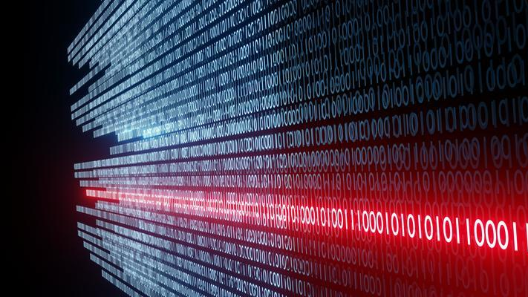
Reasons behind the computer viruses
Financial gain
To obtain financial or valuable information with the aim of threatening or harming.
Publishing the identity and earning money in exchange for decryption.
Political sabotage
Spreading of rumors or the disruption or manipulation of government organizations
Sabotage.
Pranking friends
For friends
Personal information and files and destroys them or threatens to publish them, all for the purpose of joking.

Slide 9
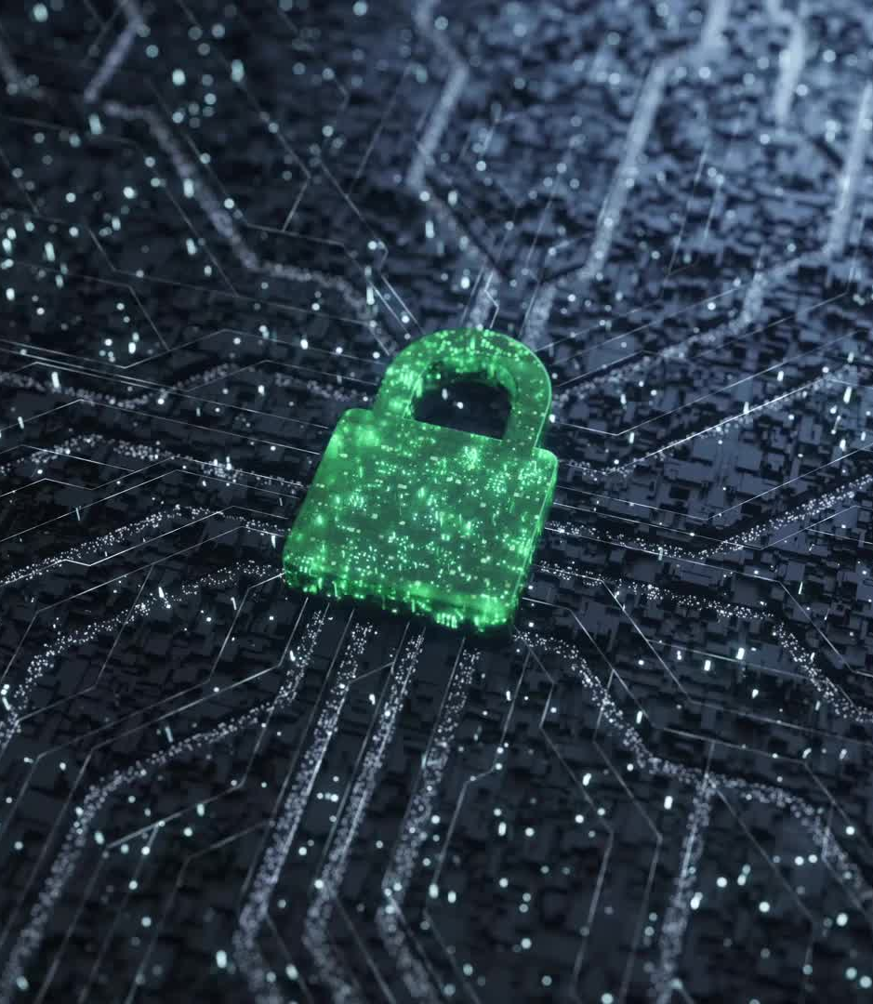
Damages Caused by Computer Viruses
Network Disruptions
network outages and compromising security systems.
System performance
slow performance due to an unknown intruder, which is the virus.
Data corruption or loss
affects the hard disk and makes it unable to read data.

Slide 10
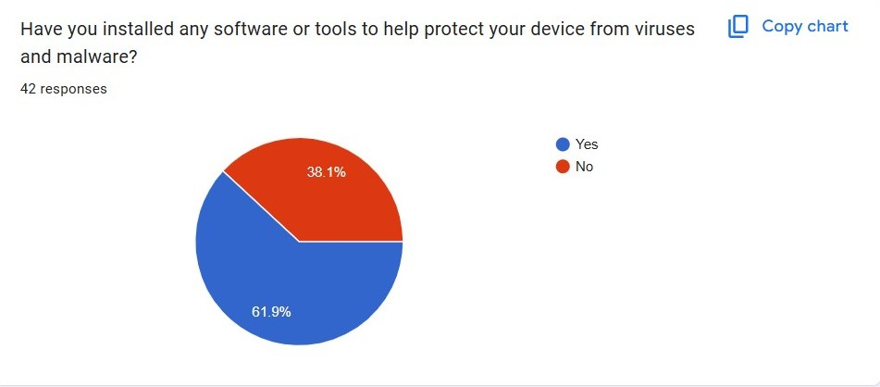
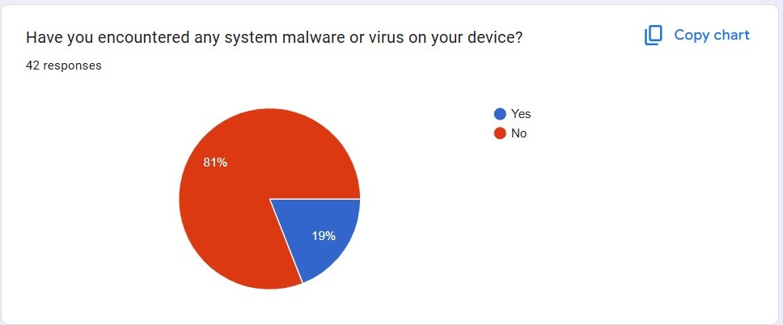

Surveys We Did :
Majority of our users have installed antivirus softwares
Some have encountered virus/malwares

Slide 11
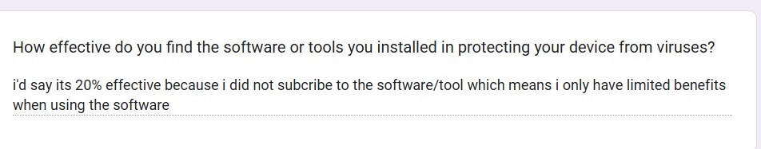

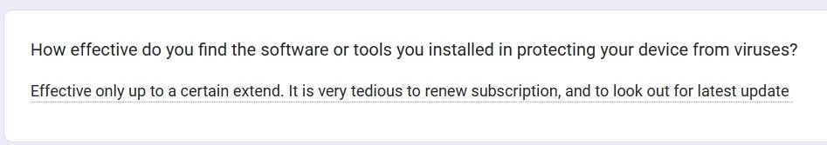
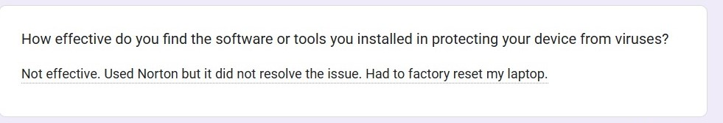
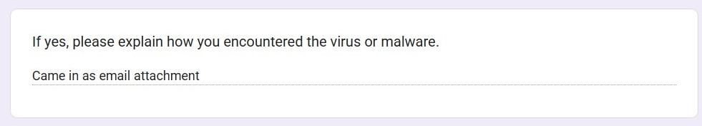
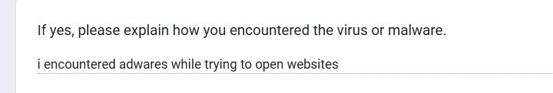
Surveys We Did :
Everyone had different experiences.
Effectiveness cannot be proven.

Slide 12

SOLUTIONS
Cybersecurity Policies
Containing the situation from the administrative side and striving to minimize damages.
Preventive Measures
Implementing preventive measures, such as antivirus programs and defense mechanisms against threats.
Recovery and Post-Infection Measures
Ensuring incident response plans and rapidly containing issues.
Data Protection
Taking backup copies of important organizational data, which is essential for protecting and recovering information.
Advanced Security Tools
Providing behavioral and environmental analysis to safeguard against threats.

Slide 13

extra precautions
Service Restoration:
Cleaning systems affected by the virus.
Security Enhancement:
Strengthening the security of the affected device and leveraging cybersecurity measures.
Reconstruction:
Rebuilding a robust network and reinforcing proactive measures.

Slide 14
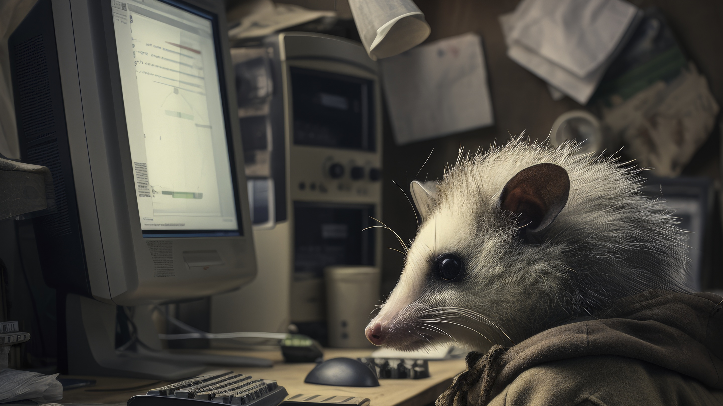
Thank you for listening

